Slide 1
Hand Gestures for Linkedin Mobıle Applıcatıon

Slide 2
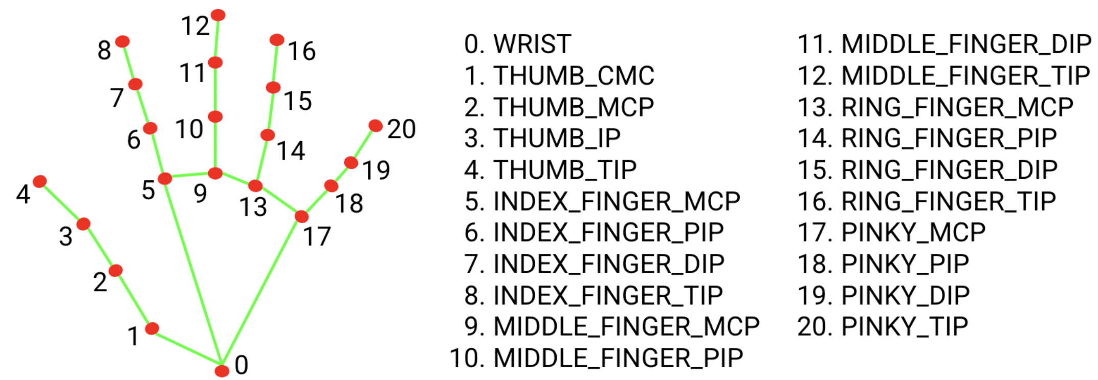
Project Modality
The project is unimodal.
MediaPipe library for hand tracking.
Movements are defined according to the position of the points on the finger joints relative to each other.
Input Data: Images from camera.
Focus: Hand gestures.

Slide 3
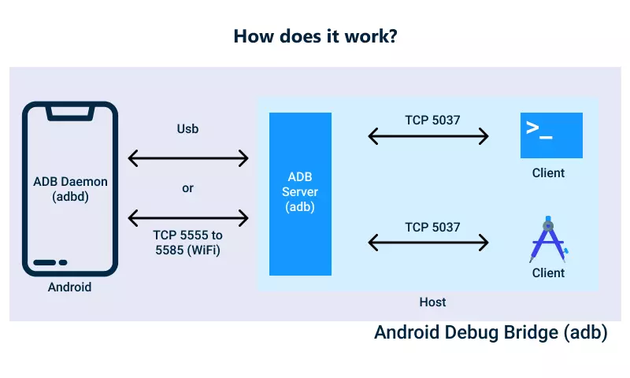
ADB (Android Debug Bridge)
Used to simulate touch commands on the phone
adb shell input tap x y
adb shell input swipe x y x y t

Slide 4
Hand gestures
There are 12 hand gestures.
Gesture outputs:
Do single tap
Do like
Do page up
Do page down
Do page right
Do page left
Go back
Go Homepage (With the back of the hand)
Go Network page (With the back of the hand)
Go Publish page (With the back of the hand)
Go Notifications page (With the back of the hand)
Go Job postings page (With the back of the hand)

Slide 5
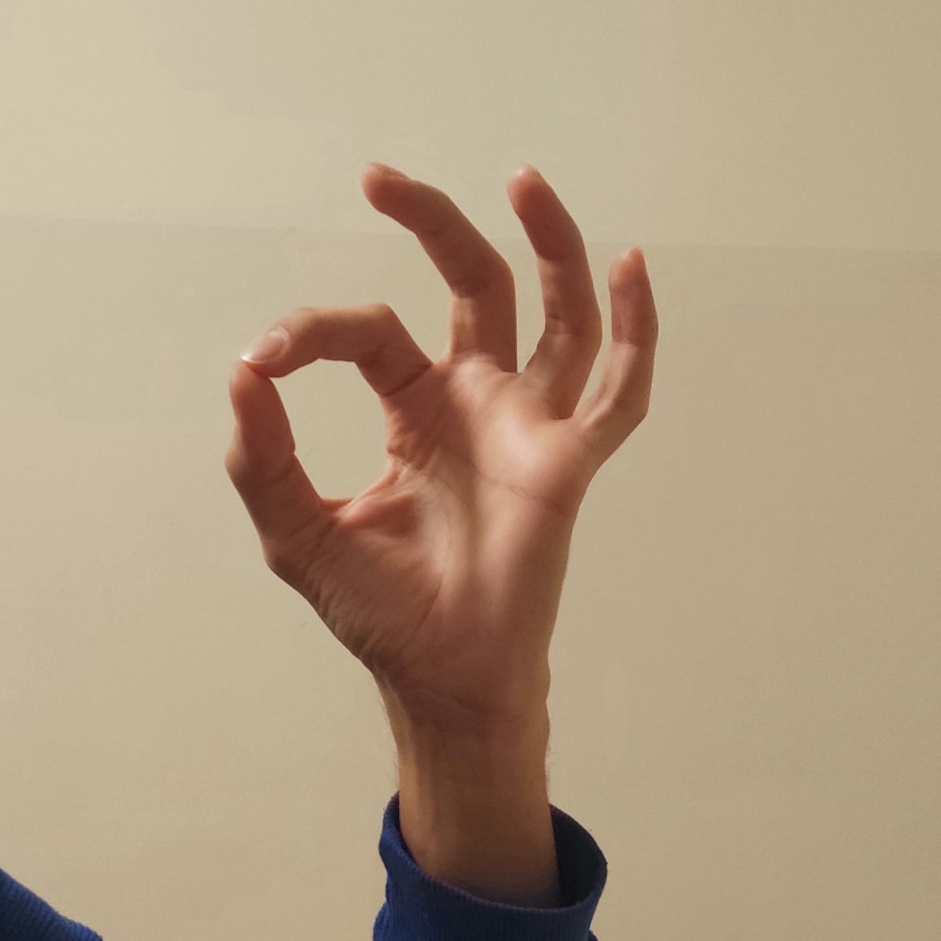
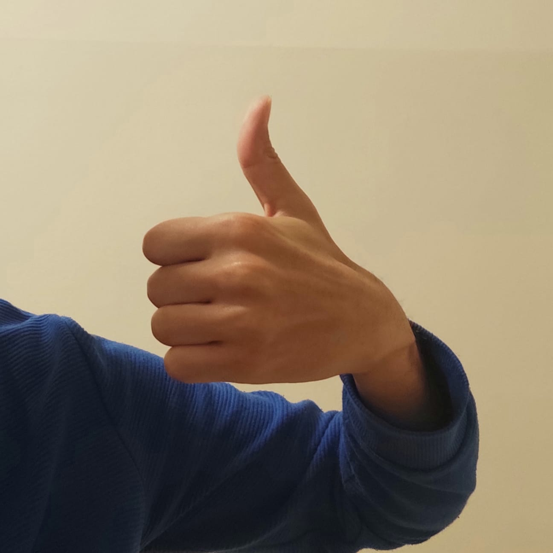
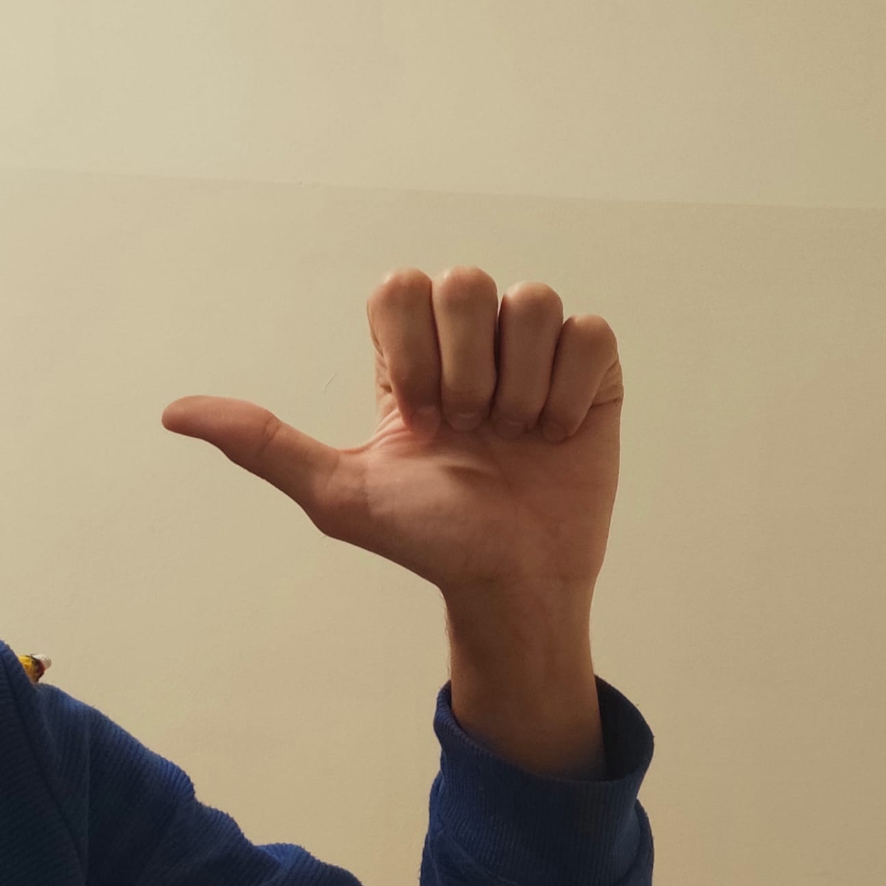
Single tap
Like
Go back

Slide 6
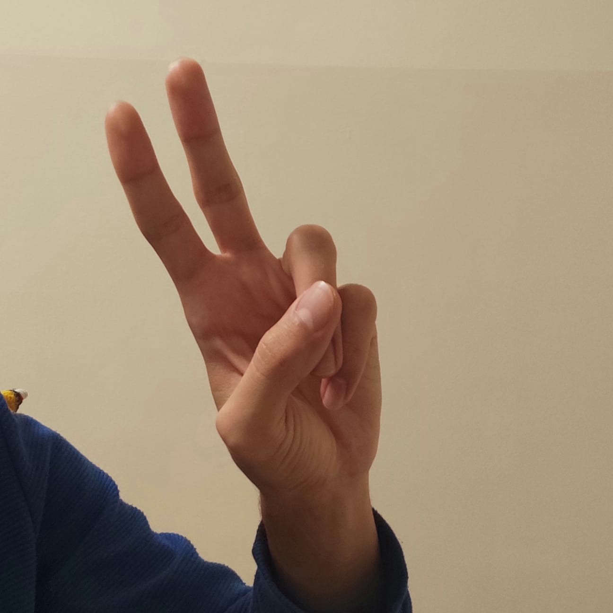
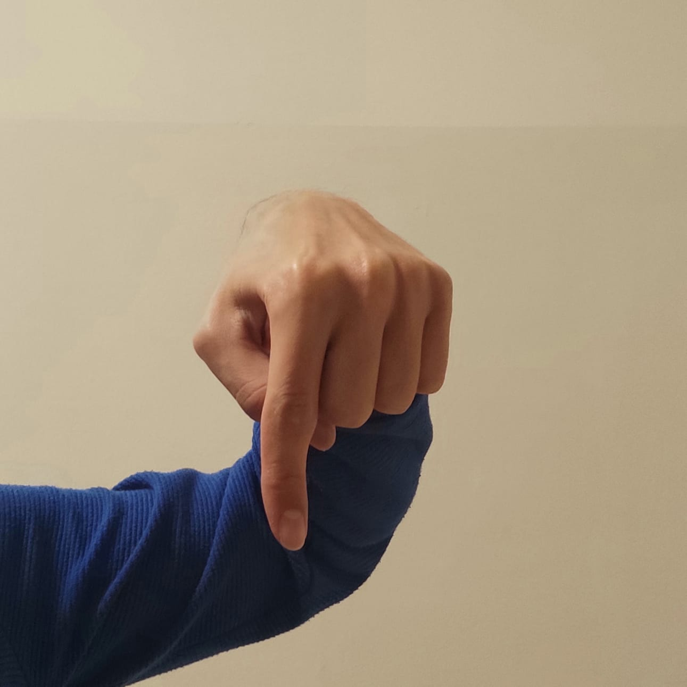
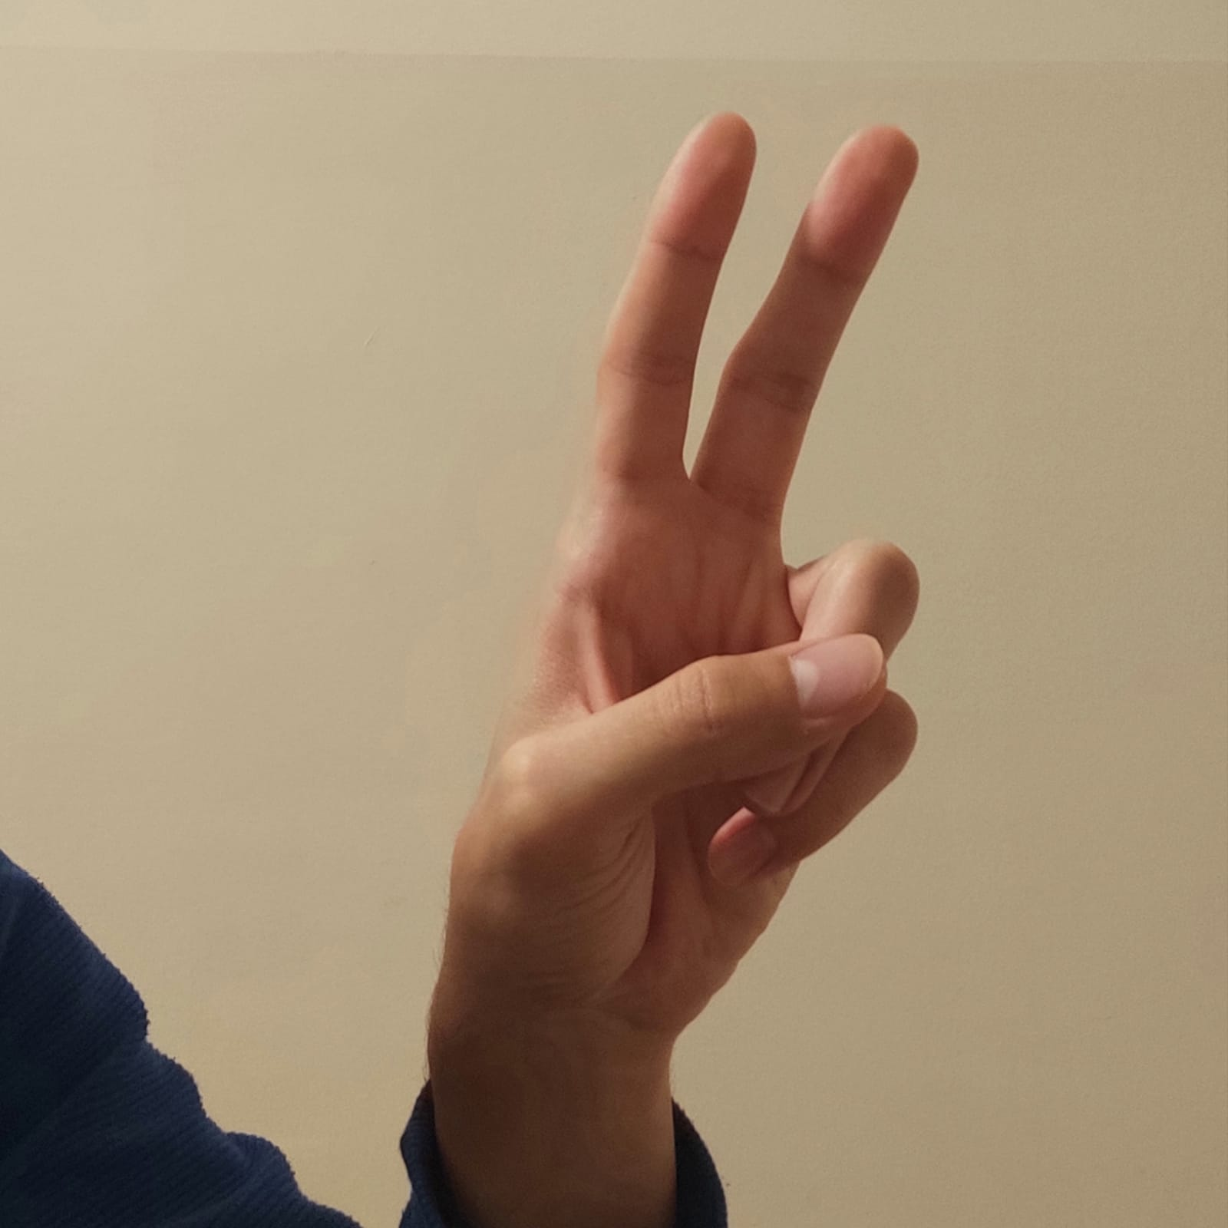
Page left
Page down
Page right

Slide 7
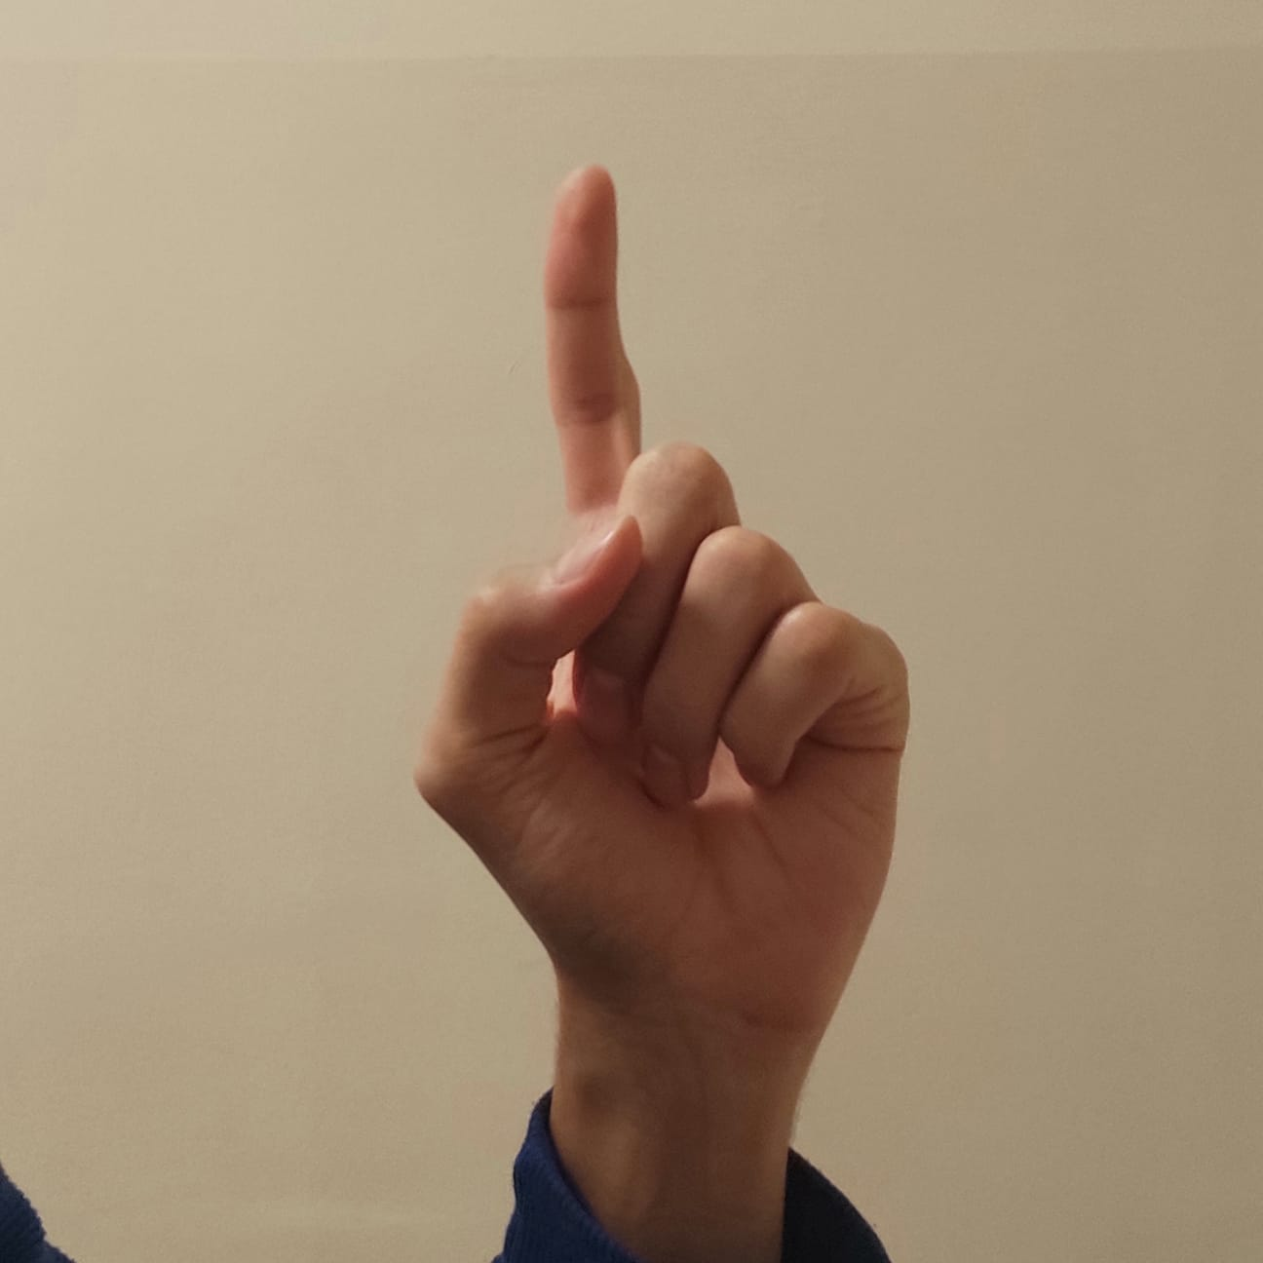
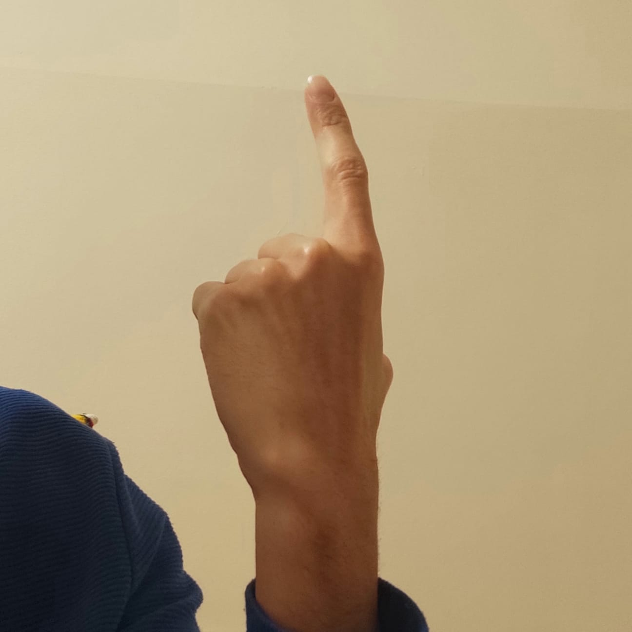
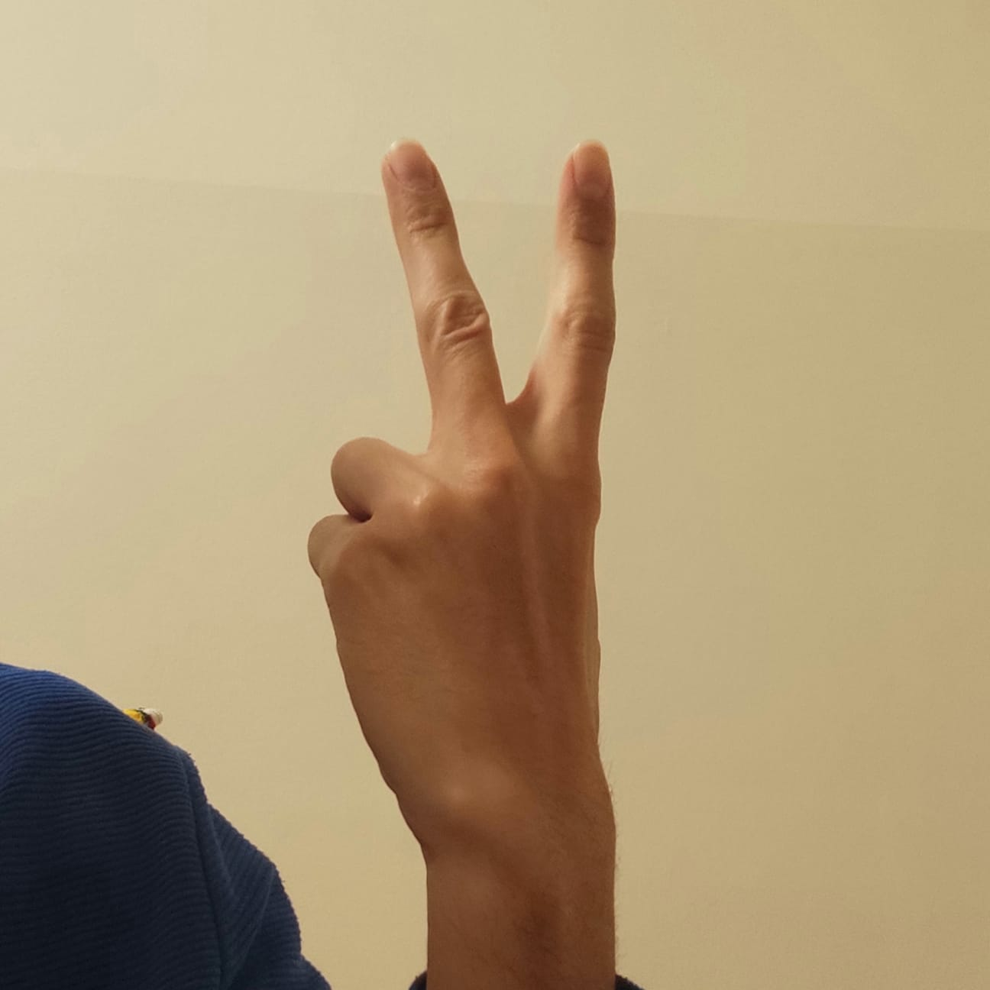
Page Up
Homepage (With the back of the hand)
Network page (With the back of the hand)

Slide 8
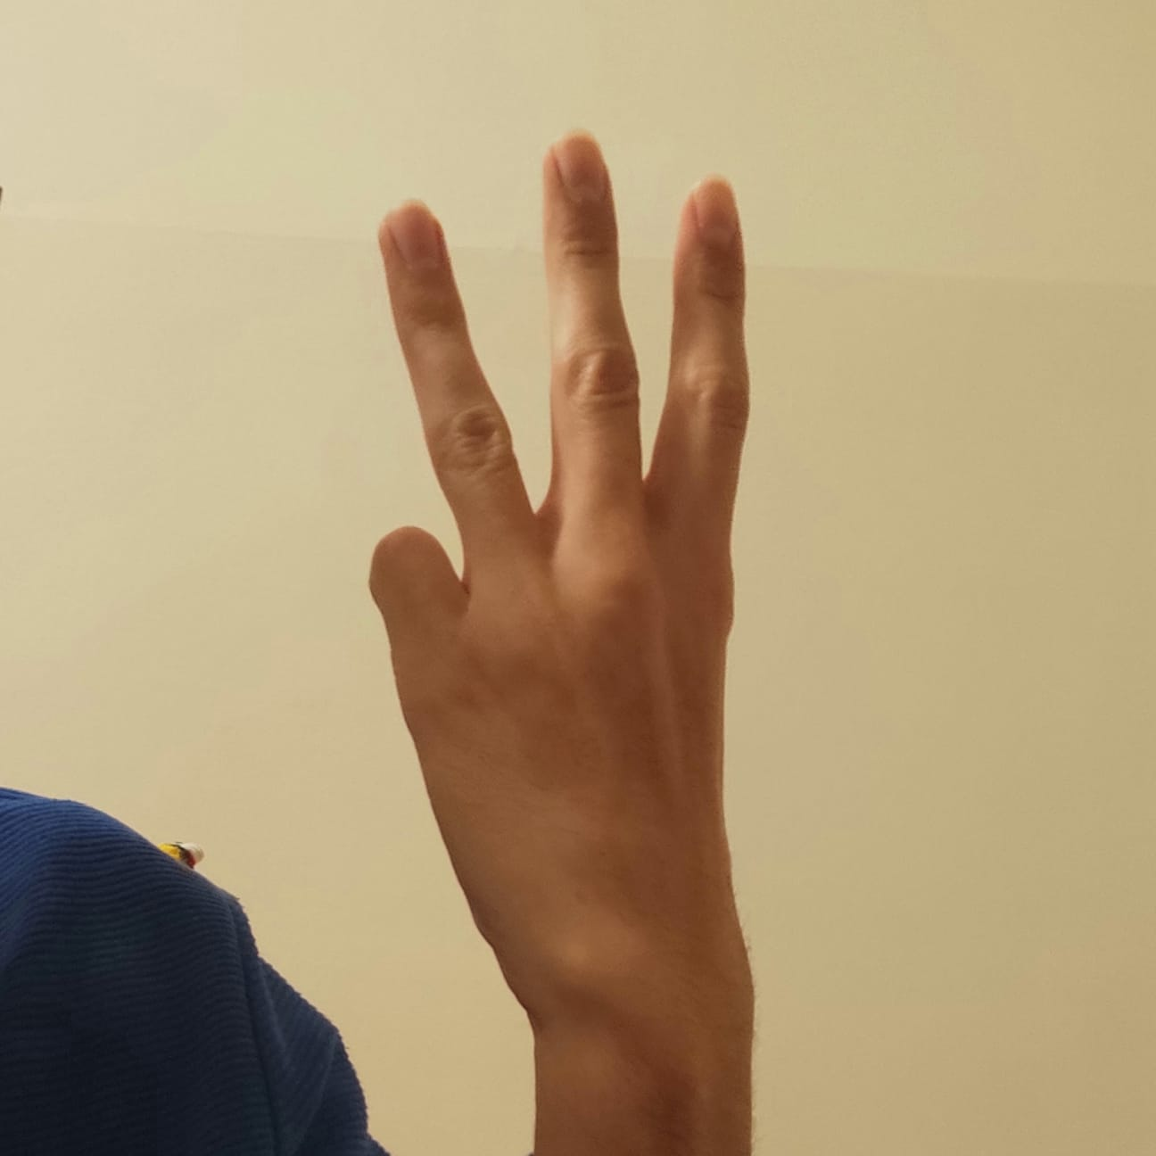
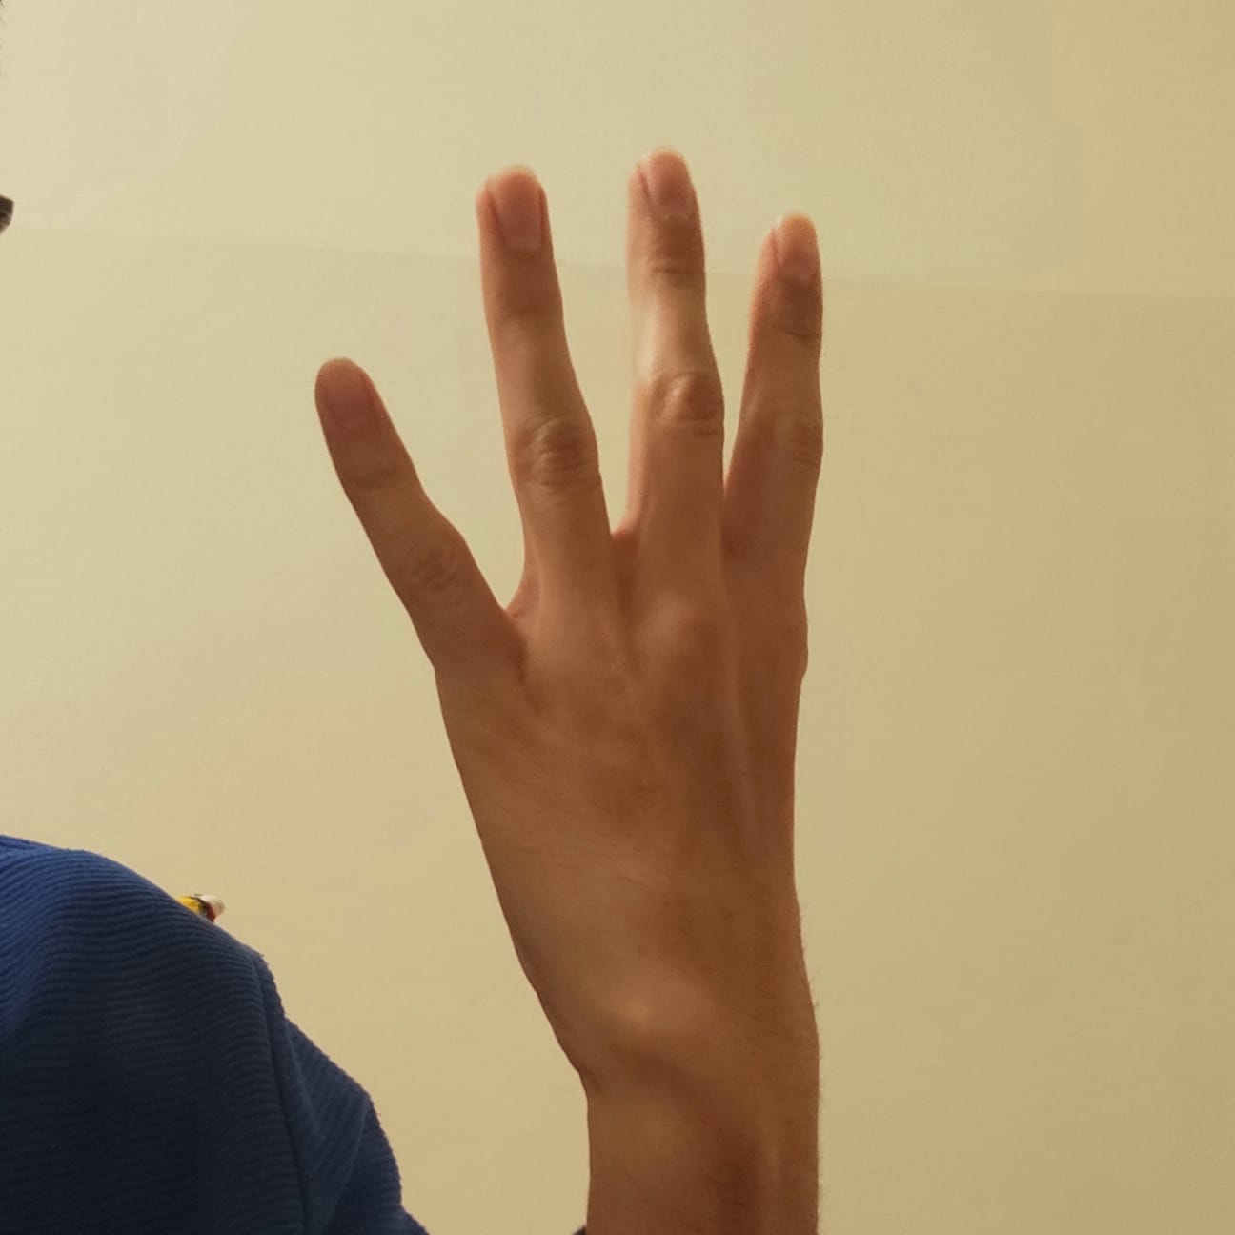
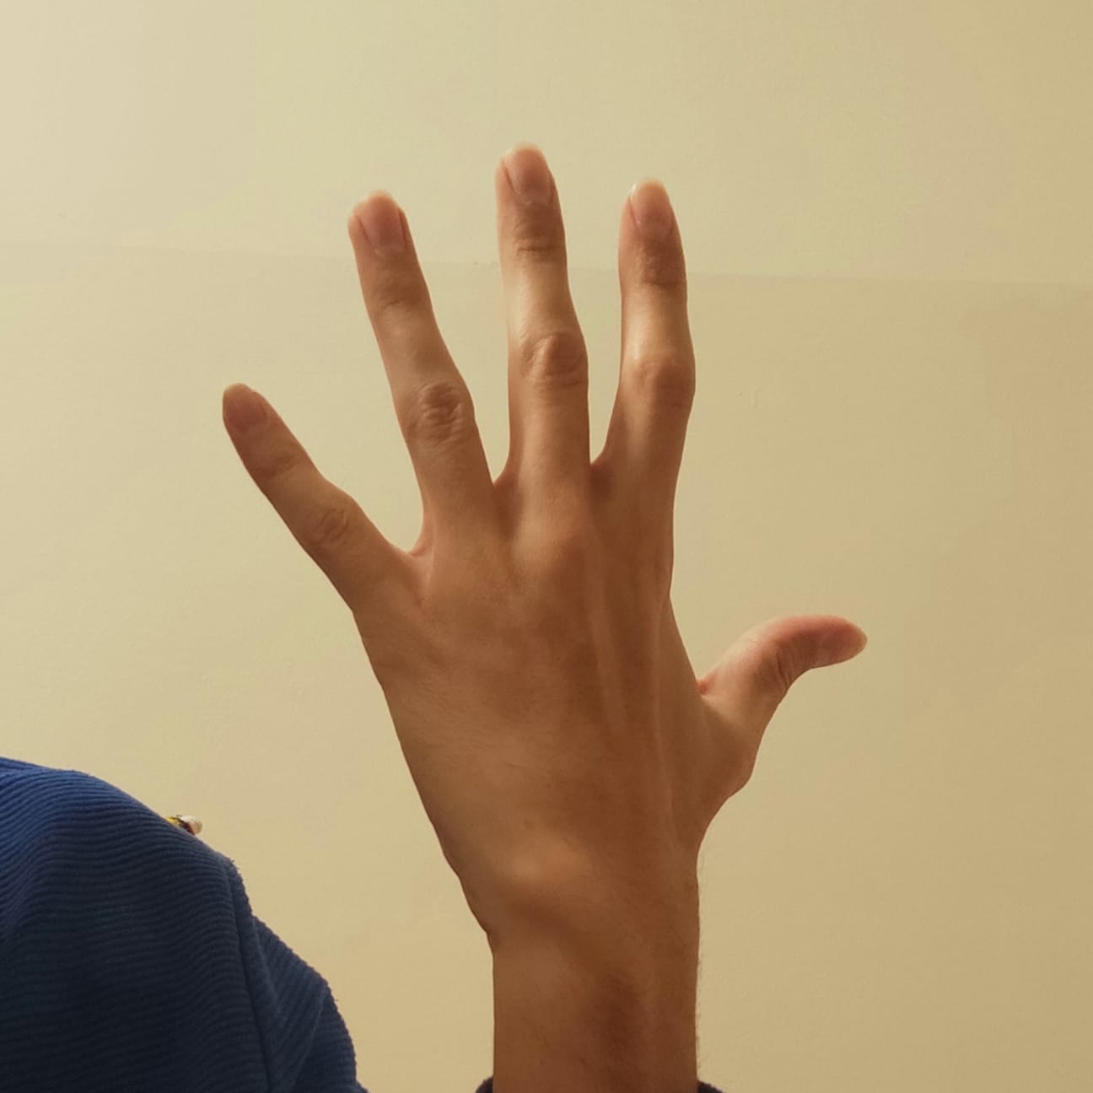
Publish page (With the back of the hand)
Notifications page (With the back of the hand)
Job postings page (With the back of the hand)

Slide 9
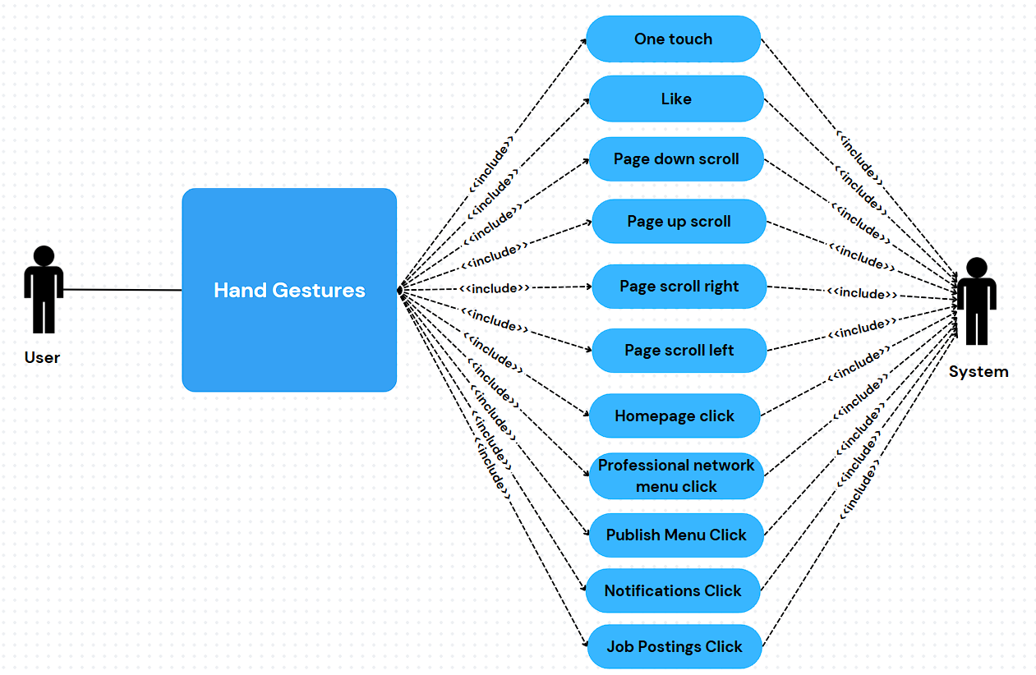
UsE CASE DIAGRAM

Slide 10
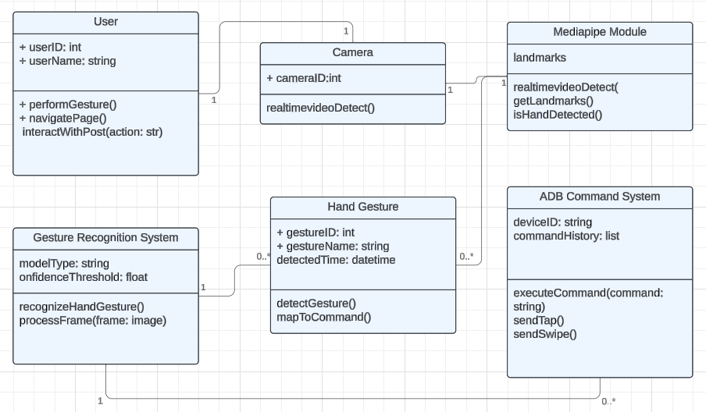
Class dıagram

Slide 11
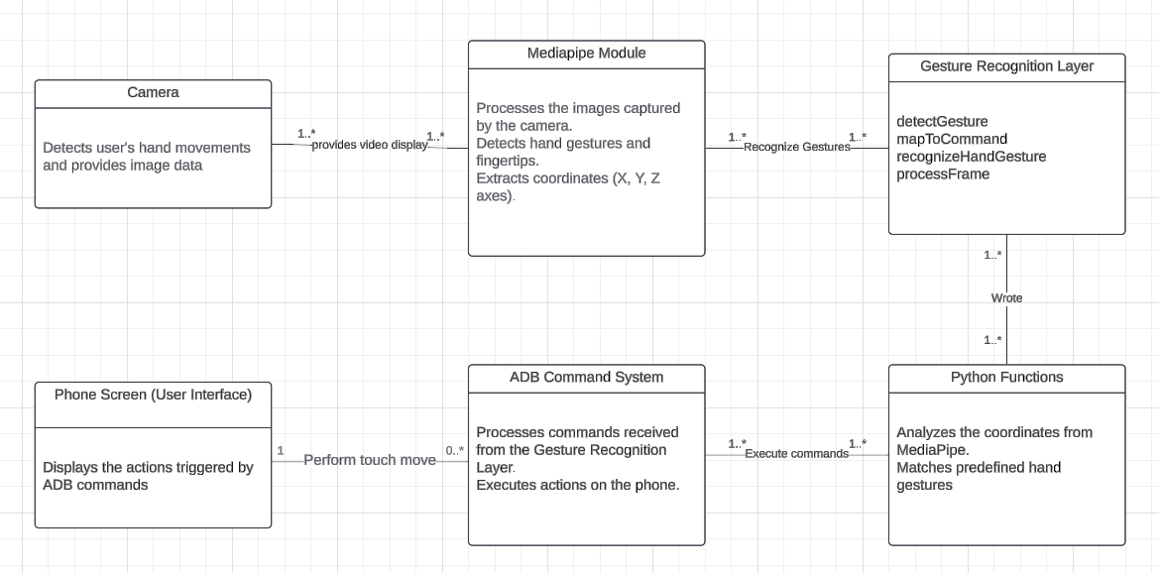
System Archıtecture

Slide 12
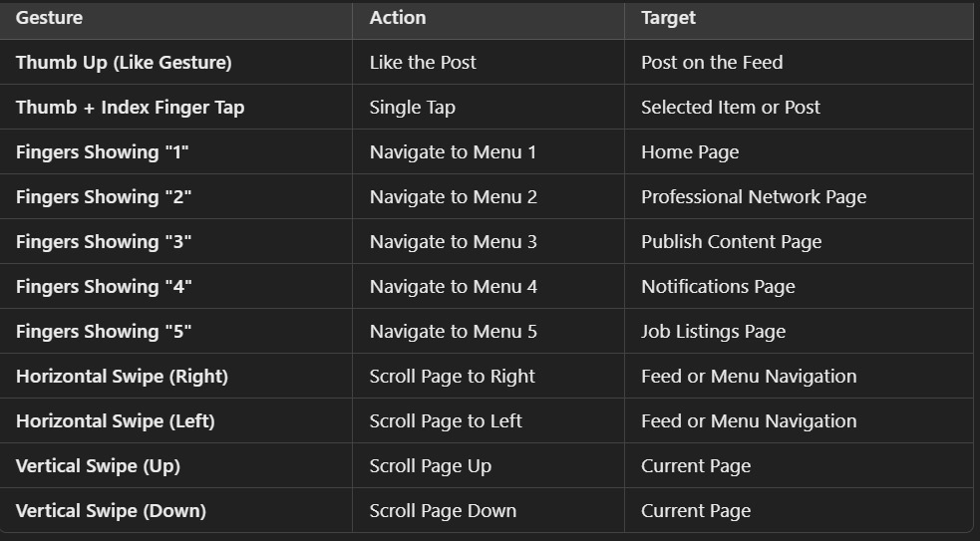
Gesture-functıon mappıng

Slide 13
Persona
Young Tech Enthusiast
Age Range: 15-35 years
Gender: All genders (Female, Male, Non-binary)
Occupation:
Students and graduates considering academic careers
Persons with physical disabilities or temporarily unable to use screen touch
Technology enthusiasts and users looking for innovative solutions
Professionals looking for efficient control methods

Slide 14
First Use Case Scenario
Erkan cannot touch the screen because his fingers are burned, but he wants to read the notifications he receives on LinkedIn.
While browsing the LinkedIn homepage by scrolling down the page, he goes to the notifications by raising 4 fingers with the back of his hand.
He reads the notifications by scrolling down the page.
He scrolls up the screen once to reveal the buttons to return to the homepage.
He goes back to the homepage by raising 1 finger with the back of his hand.

Slide 15
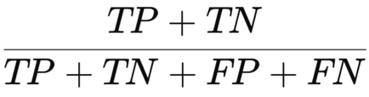
First Use Case Scenario
Gestures | True Positive | True Negative | False Positive | False Negative | Accuracy
Page down | 43 | 28 | 19 | 8 | 0.72
Notifications Page | 52 | 30 | 8 | 9 | 0.82
Page down | 44 | 29 | 20 | 7 | 0.73
Page up | 36 | 31 | 25 | 10 | 0.67
Homepage | 42 | 28 | 19 | 12 | 0.70
TP: 212
TN: 146
FP: 96
FN: 46
TOTAL : 500
Accuracy: (212+146)/(212+146 +96+46) = 0.716
Errors: FP+FN
96+46 = 142

Slide 16
sECOND Use Case Scenario
Semih dropped his phone on the ground, which broke the screen touch feature.
Semih, while on the LinkedIn homepage, slides his finger in the air over the camera to scroll down and continues browsing.
He sees an informative post shared in multiple images and opens the image by touching his index finger and thumb together once.
He moves on to the next photos by making a right-to-left swipe gesture in the air with his finger.
He makes the stepping back gesture and goes back and likes the photo by giving the thumbs up sign.

Slide 17
First Use Case Scenario
Gestures | True Positive | True Negative | False Positive | False Negative | Accuracy
Page down | 45 | 33 | 16 | 6 | 0.78
Notifications Page | 34 | 32 | 20 | 12 | 0.66
Page down | 46 | 34 | 16 | 5 | 0.79
Page up | 55 | 32 | 5 | 8 | 0.87
Homepage | 45 | 33 | 16 | 7 | 0.77
TP: 225
TN: 164
FP: 78
FN: 33
TOTAL : 500
Accuracy: (225+164)/(225+164 +78+33) = 0.778
Errors: FP+FN
78+33 = 111

Slide 18
Third Use Case Scenario
While eating, Ali wants to look at the job postings on LinkedIn.
He raises his 5 fingers with sweat to enter the job postings page.
He scrolls down the page and examines the job postings.
He clicks on the posting with a single touch to read the details of an ad he likes.
He scrolls down the page to read the details of the ad.

Slide 19
First Use Case Scenario
Gestures | True Positive | True Negative | False Positive | False Negative | Accuracy
Page down | 45 | 26 | 8 | 2 | 0.87
Notifications Page | 44 | 25 | 9 | 2 | 0.86
Page down | 40 | 26 | 14 | 1 | 0.815
Page up | 39 | 25 | 13 | 2 | 0.81
Homepage | 28 | 25 | 16 | 10 | 0.65
TP: 197
TN: 127
FP: 67
FN: 9
TOTAL : 400
Errors: FP+FN
67+9=76
Accuracy: (197+127)/(197+127 +67+9) = 0.81

Slide 20
Tools
Python
MediaPipe
OpenCv
PyAutoGUI
Time
Subprocess
ADB (Android Debug Bridge)

Slide 21
Thank you

